Slide 1
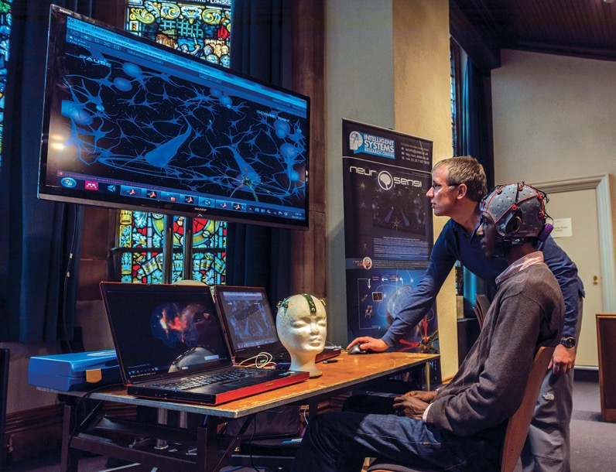


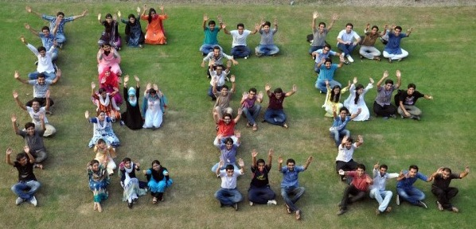



IEEE at a Glance

Slide 2


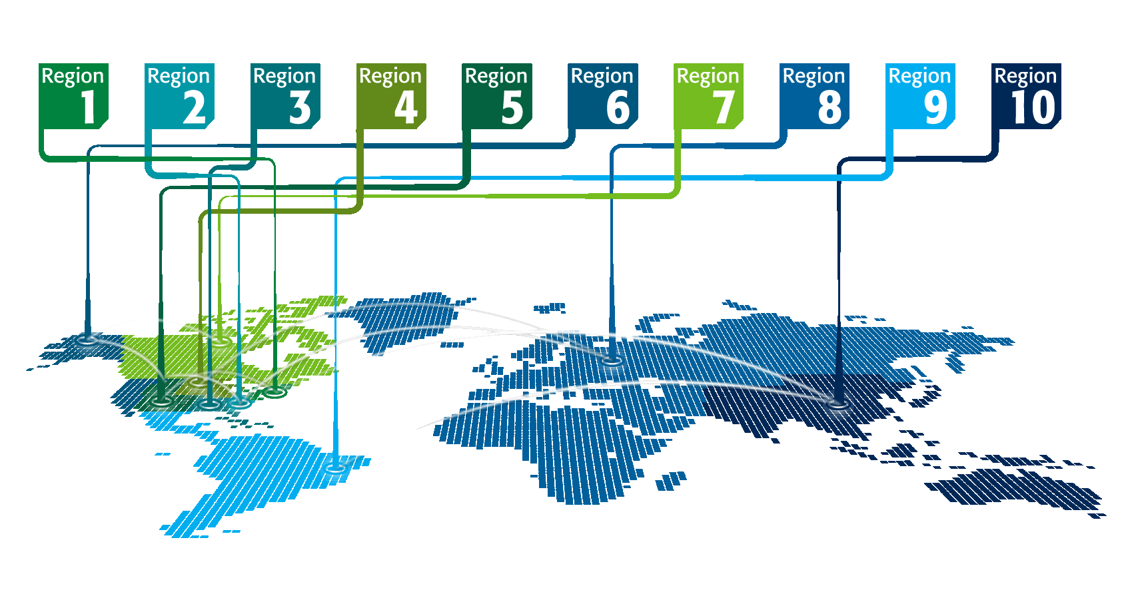

IEEE at a Glance
IEEE has…
Over 400,000 members
in more than 160 countries,
more than 60 percent of whom are
from outside the United States
More than 107,000 Student members
342 Sections in ten geographic
Regions worldwide
2,562 Chapters that unite local members with similar technical interests
3,485 Student Branches at colleges and universities in over 100 countries
2,877 Student Branch Chapters of IEEE technical Societies
580 affinity groups and growing
All figures stated above are current as of 04/2021.

Slide 3
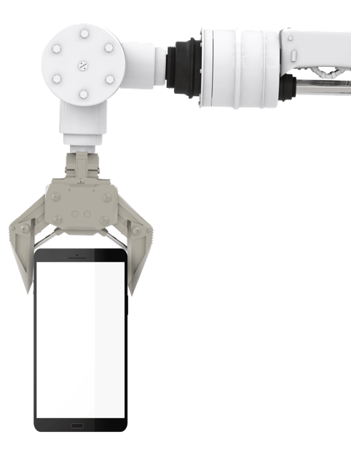



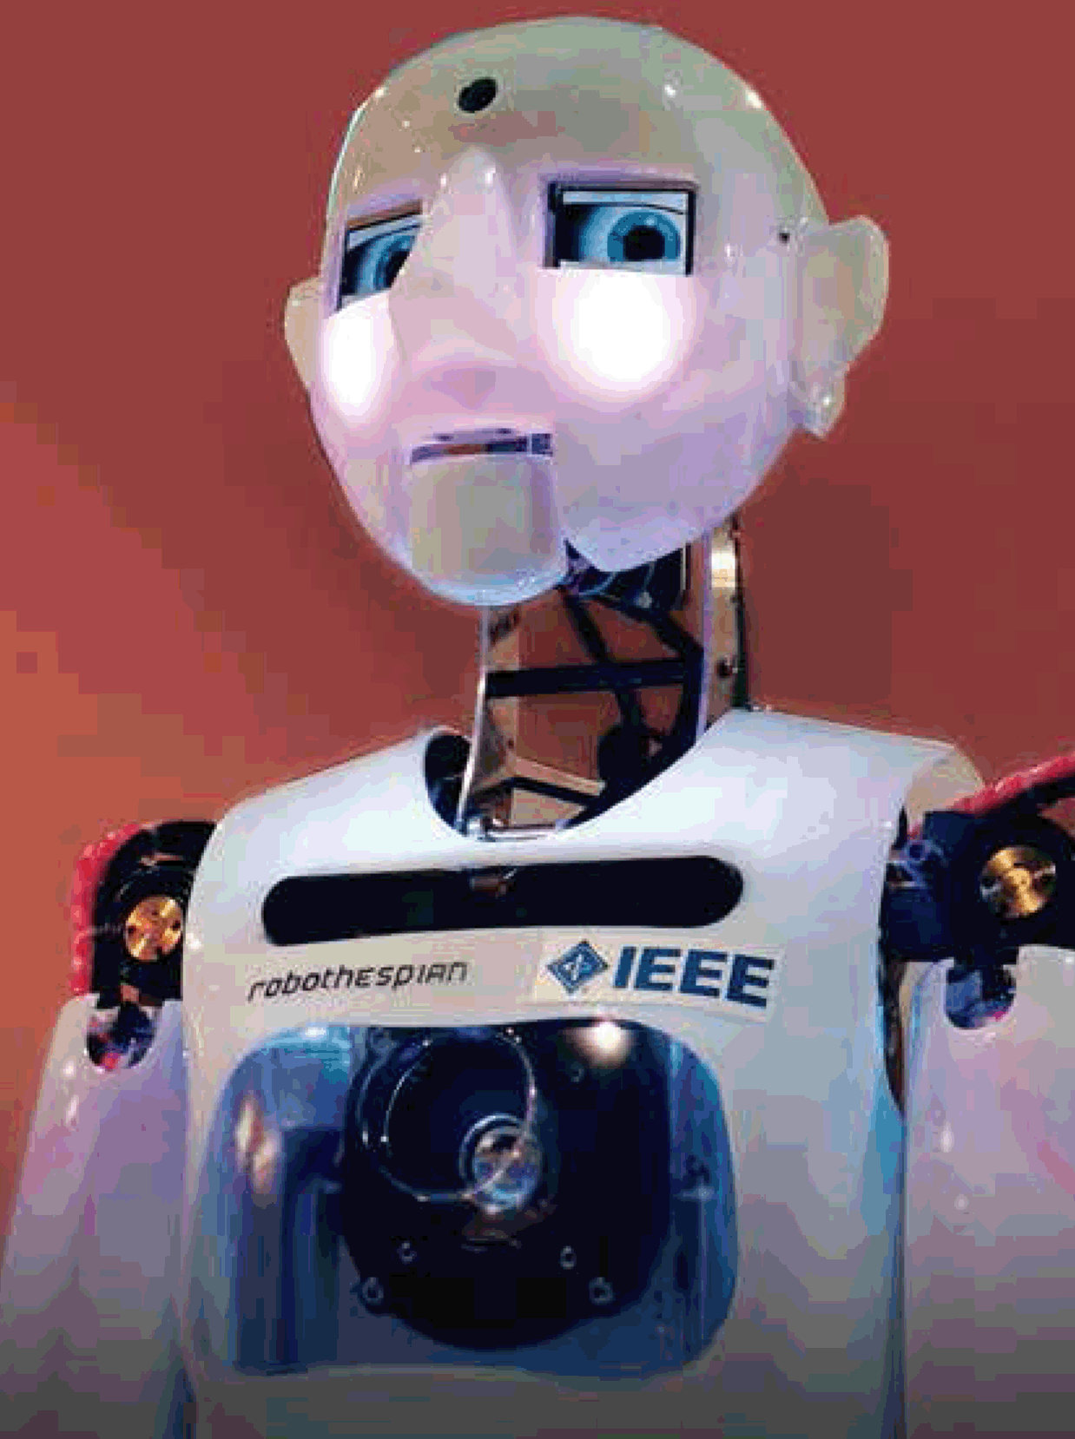
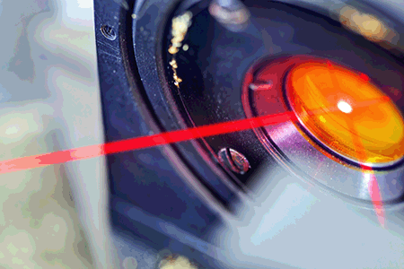


IEEE at a Glance
IEEE…
Has 39 technical Societies and seven Technical Councils representing the wide range of
IEEE technical interests
Has more than 5 million documents in the
IEEE Xplore® digital library, with more than 15 million downloads each month
Has an active portfolio of nearly 1,200 standards and more than 900 projects
under development
Publishes approximately 200 transactions, journals, and magazines
Sponsors more than 1,600 conferences in 96 countries annually
All figures stated above are current as of 04/2021.

Slide 4




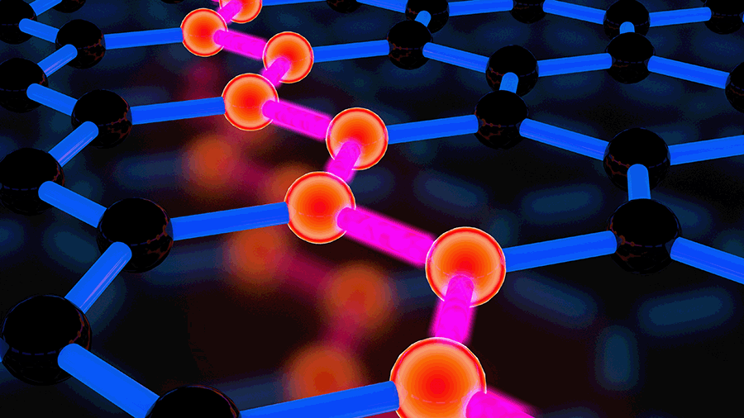


IEEE at a Glance
And…
IEEE journals, conference proceedings, and standards, plus select content dating back to 1872
Partnering with more than 1,400 non-IEEE
entities globally
Attracting more than 561,000 conference attendees
Publishing more than 1,800 conference proceedings via IEEE Xplore
All figures stated above are current as of 04/2021.

Slide 5









Come with us to the future
Cloud Computing
Information Storage
Machine Learning
Power Systems
Smart Grid
Medical Devices
Robotics
Semiconductors
Telecommunications

Slide 6
Learn more at www.ieee.org

